Slide 1


Micro Project on “Smart Charger Monitoring System Using Arduino”
KLE DR. M. S. Sheshgiri College of Engineering & Technology
Department of Electronics and Communication Engineering
Members with USN Team
1.Suraj Navalagi (2kl18ec103)
2.Rahul Doddalingappgol (2kl18ec071)
3.Sameena Padasalagi (2kl18ec081)
4.Shilpa Sonappa Sunkar(2kl18ec087)
Under the Guidance of
Prof. Anand K

Slide 2
INTRODUCTION:
Almost every mobile phone user faces this one issue: connecting your phone to the charging adapter and forgetting that you plugged in the device.
Almost all the modern charge controllers on mobile phones are very advanced and detect when your battery is fully charged and disconnect supply of power to the battery (not completely but a keeps the device in a charging state known as trickle charge).
But the main disadvantage of keeping the device plugged in even after the battery is full is its affect on the lifetime of the battery. Every battery has a limit to the number of times it can be charged (known as charge cycles).
Also, temperature plays an important role in the life of a battery. Higher temperatures might disrupt the chemistry of the battery.
But what if I told you that the Arduino based Smartphone Charging Controller project can be help full to control the charging time and once the time is up, the power to the charging adapter is disconnected. Sounds interesting and practical, right.

Slide 3
OBJECTIVES:
Create a “smart”, customizable, all in one system.
Focus on friendly user control
Can integrate easily with existing home electricity system.
Easily configuration and low cost.

Slide 4
METHODOLOGY:
After making the necessary connections as per the circuit diagram, upload the code to Arduino and turn on the power supply.
We will get Hours (HH), Minutes (MM), Seconds (SS) on the 16×2 LCD Display. By selecting Hours, rotate the knob on the rotary encoder to set the desired number of hours. When the hours value is set, push the knob to fix that value.
Similarly, we can set minutes and seconds. After everything is set, select OK on the LCD and push the knob. Now, the relay gets activated (which means the phone starts charging) and the countdown begins for the amount of time set by us.
Once the countdown reaches “0”, the relay is turned off (power to adapter is off).

Slide 5
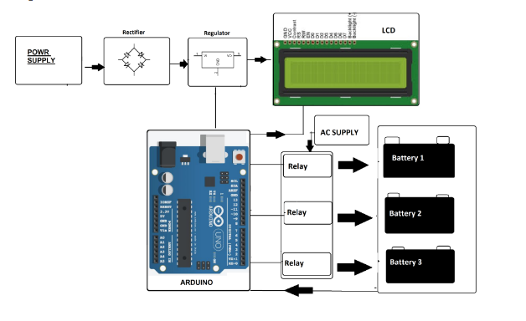
Circuit Diagram

Slide 6
OUTCOMES:
Arduino based Smartphone Charging Controller is implemented here which a simple project for controlling the amount of time we charge our mobile phone.
Using this project, we can plug in our phone to the charger, set the time for which our phone gets charged and forget as the project will automatically disconnect power to the charger.
This project is very useful for people who tend to charge the phone during night time or those who often forget that they plugged in the phone to the charger.

Slide 7


